Slide 1
DeComm Hackathon
Hamad Alatawi - Ali Alojaimi - Bader Omran

Slide 2

01
Oxford - DeComm

Slide 3
Oxford Coding4Integrity 2.0 – Decomm Requirements
Key Features to be Included:
Access via Full Name
Multi Currency Support (fiat and crypto)
Buyer and Seller modes for all users
Product listing with images descriptions, and pricing
Shopping cart and checkout functionality
Currency exchange calculations every 10 minutes
Transaction record keeping for buyers and sellers
Technical Implementation
Built on the internet computer platform
Uses HTTP Outcalls for currency exchange rates
Stores images on-chain
Pauses currency calculations when user is idle
No actual currency transactions or wallets created
Illustrates multi-currency commerce concept

Slide 4





Oxford Coding4Integrity 2.0 – Decomm
Motoko
Svelte
SPA
Design
Documents
Mobile
First

Slide 5
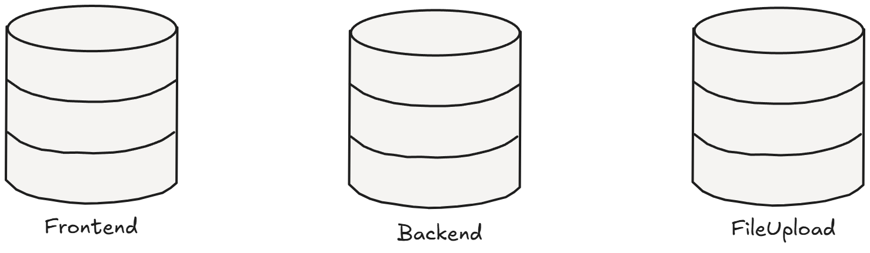
Oxford Coding4Integrity 2.0 – Decomm Canister Architecture
Lib/
(admin)
(app)
Main.mo
ObjetTypes.mo
Product.mo
Transaction.mo
Types.mo
User.mo
Main.mo
Types.mo

Slide 6
02
DeComm

Slide 7
Decomm Grant Requirements
Key Features to be Included:
Polish and refine the frontend features.
Refactor all canisters both frontend and backend.
Refine the authentication method.
Refine the purchasing method and replace all cryptocurrencies & fiat with the knowledge token
Add Knowledge Token NFT Integration endpoints for future participants.

Slide 8
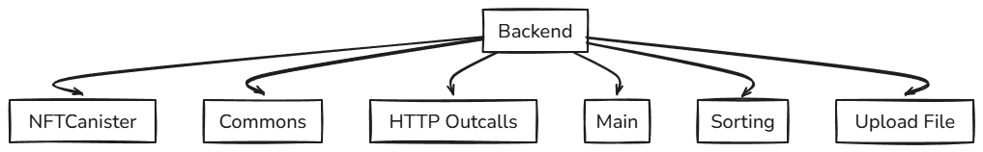
Oxford Coding4Integrity 2.0 – Decomm Canister Architecture

Slide 9
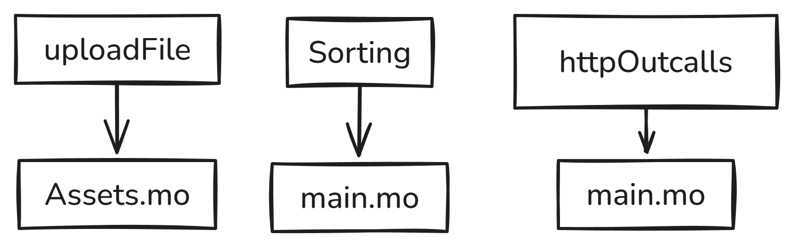
Oxford Coding4Integrity 2.0 – Decomm Canister Architecture

Slide 10
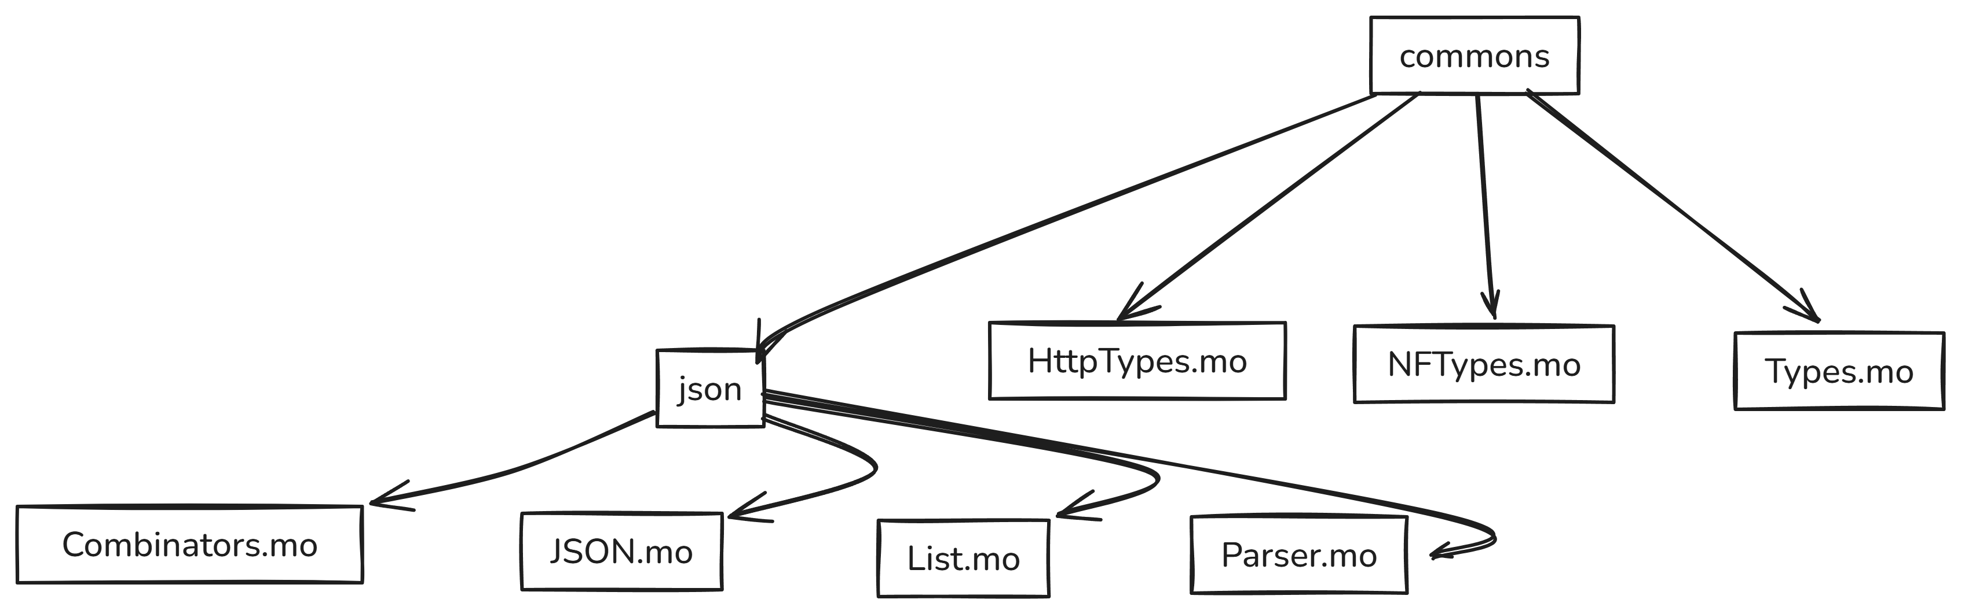
Oxford Coding4Integrity 2.0 – Decomm Canister Architecture

Slide 11
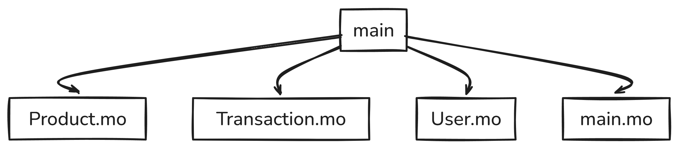
Oxford Coding4Integrity 2.0 – Decomm Canister Architecture

Slide 12
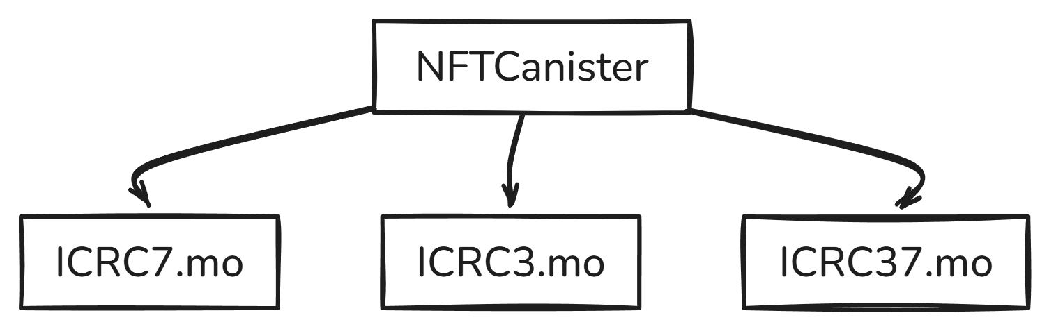
Oxford Coding4Integrity 2.0 – Decomm Canister Architecture

Slide 13
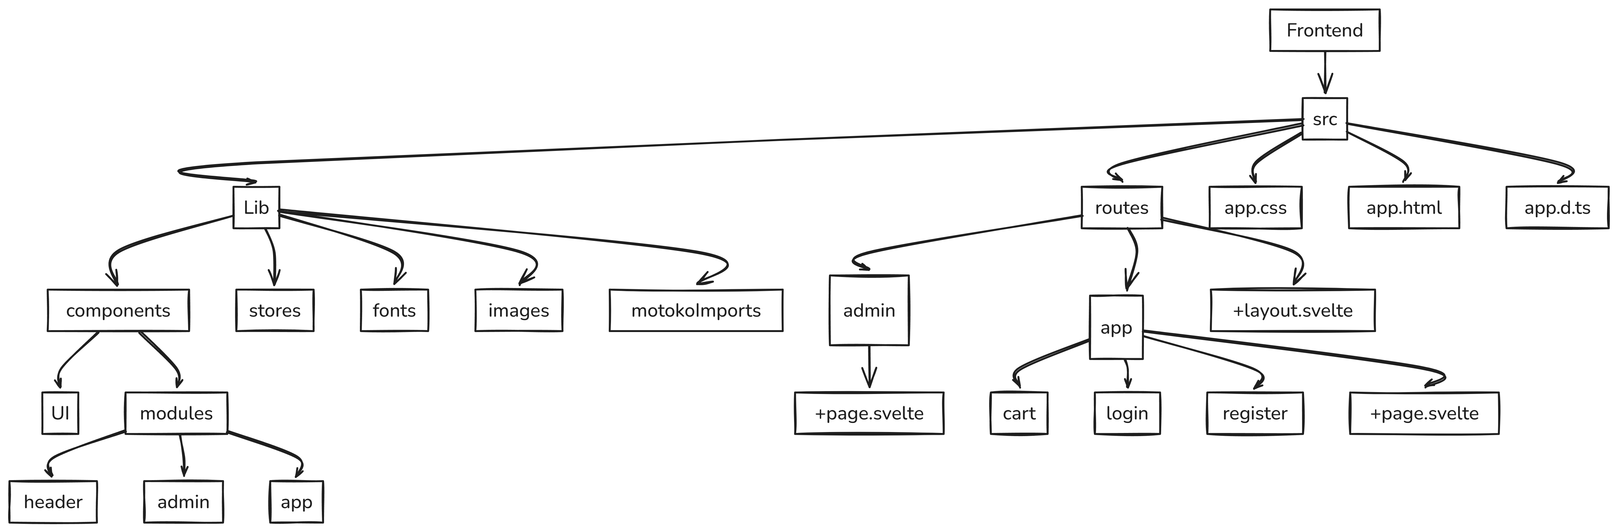
Oxford Coding4Integrity 2.0 – Decomm Canister Architecture

Slide 14
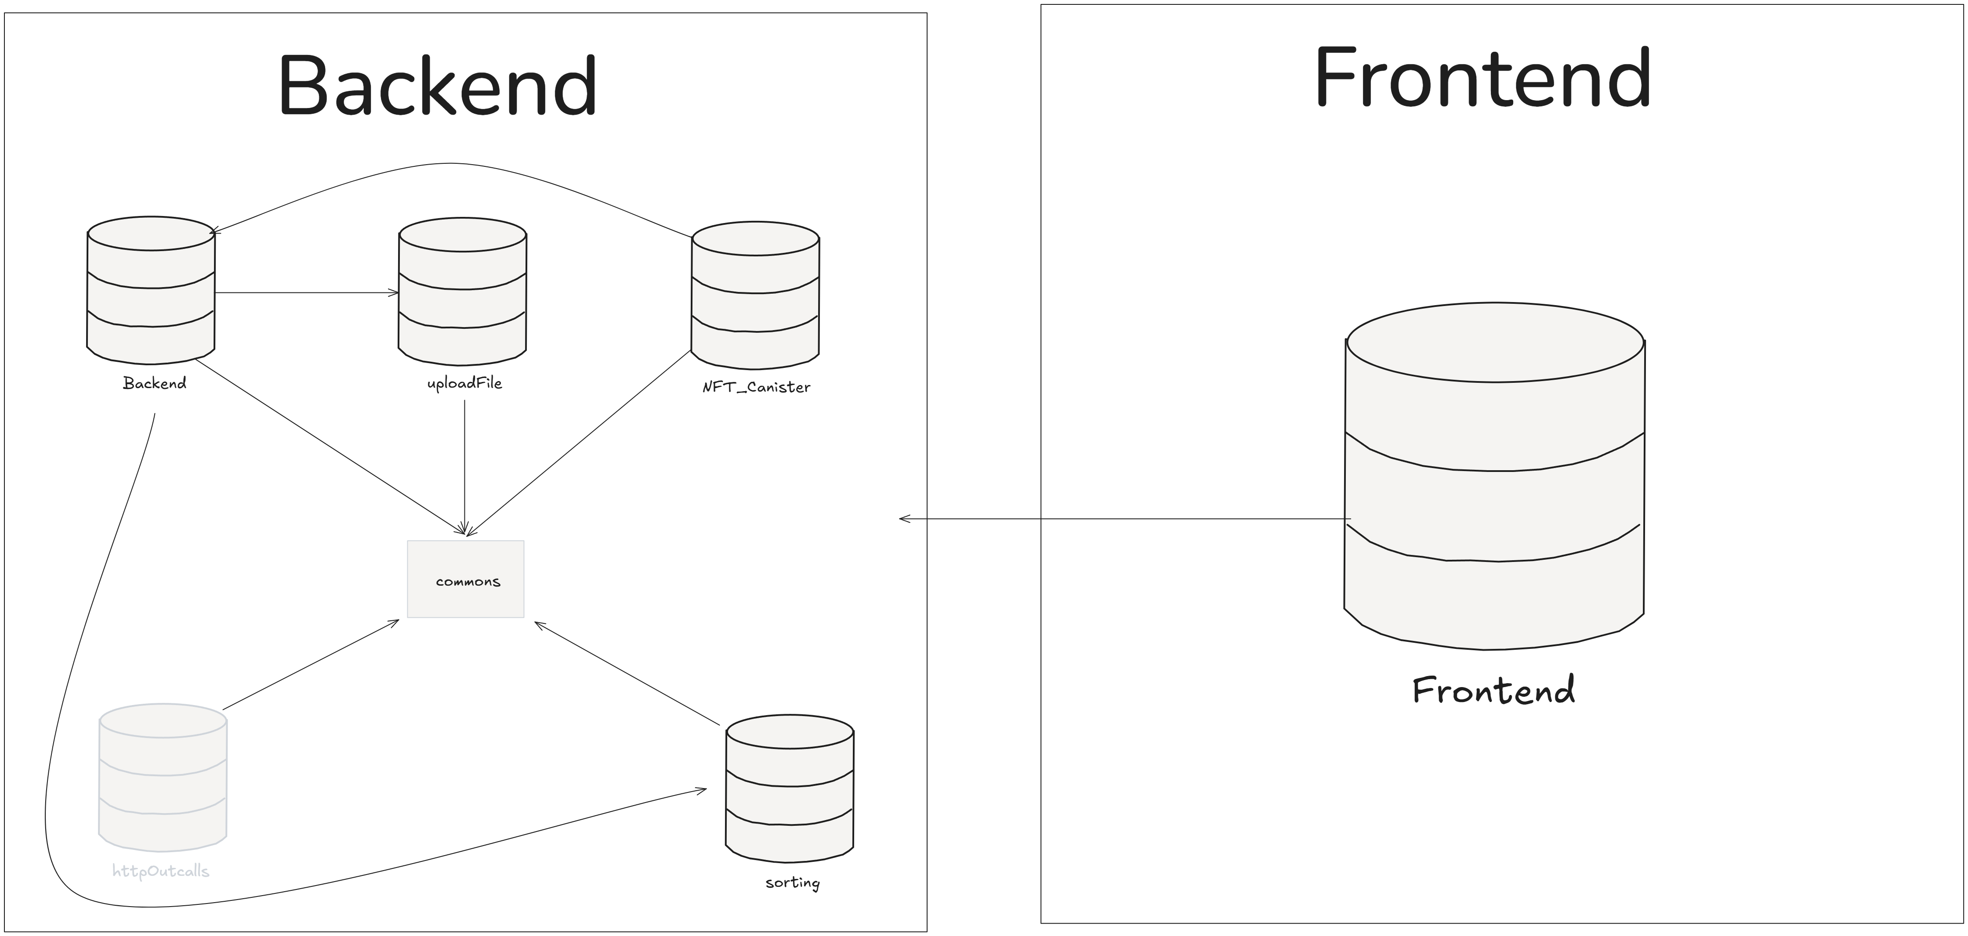
Oxford Coding4Integrity 2.0 – Decomm Canister Architecture

Slide 15
Milestones and objectives
Pertoria Hackathon
Collaboration
Build Platform
Launch
Implement the NFT transactions.
Collaborate with the winnning teams and implement the newest solutions.
Build a production grade DeComm platform
Launch the application worldwide.

Slide 16
Key to winning
Scope
Code
Understand the tasks in hand. Right them down and spend time on how you’ll architect and approach the implementations.
Understand the code structure and how things works. Eg.. Creation of canisters, inter-canister interactions, frontend invocations.
Divide and Conquer
Breaks
Sepearte the requirements into smaller sized chunks, and give them a list of priority. Based on what is the most important things you need to implement and what can you technically implement.
It’s important to take breaks when needed. Once you reach a mental block take a break and re-vist the problem. If the problem persists re-prioritize your tasks and move on to another one.

Slide 17
Thank You!

